Slide 1
Programmable Objects
Part 2

Slide 2
cursors
Cursors are used to fetch one row at a time.
Cursors have five components:
Declare
Select
Open
Fetch
Close

Slide 3
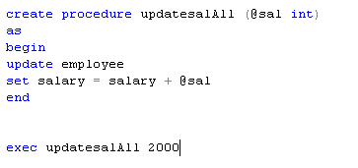
Stored procedure to update salary of all employees

Slide 4
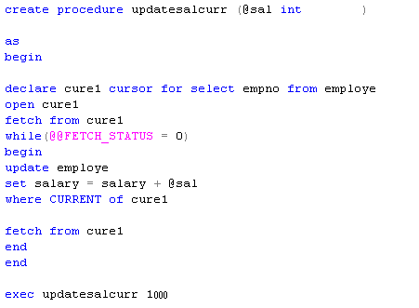
Update salary of all employees with cursors

Slide 5
Write stored procedure to Update salary of any number of employees using cursors

Slide 6
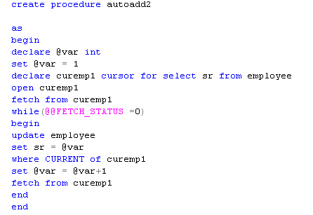
Cursors example to enter incremental values in any column

Slide 7
Triggers
Triggers are special type of stored procedures.
Automatically executes when DDL and DML statements associated with triggers executes.

Slide 8
DDL Triggers
Create
Alter
Drop
For/After (create/alter/drop)
AFTER specifies that the DML trigger is fired only when all operations specified in the triggering SQL statement have executed successfully. All referential cascade actions and constraint checks also must succeed before this trigger fires.
AFTER is the default when FOR is the only keyword specified.

Slide 9
DML Trigger
Insert
Update
Delete
After ( insert, update, delete)
Instead of ( insert, update, delete)
Specifies that the DML trigger is executed instead of the triggering SQL statement, therefore, overriding the actions of the triggering statements. INSTEAD OF cannot be specified for DDL triggers and DML.

Slide 10
When a trigger is executed , two special tables inserted and deleted are available.
These tables help to maintain the record of updates.

Slide 11
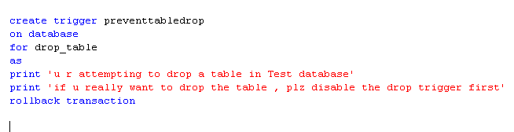
Example of DDL Trigger

Slide 12
Example of DML trigger
Create a DML trigger on student table to maintain the record of updates. Maintain a separate table to record the inserted and deleted information.

Slide 13
Student_id | Student_name | Student_address | Department_id
1 | Ali | Abc | 001
2 | Omer | Def | 002
3 | Usman | Ghy | 003
4 | Humza | Hju | 004
Student
Deparment_id | Department_name
001 | CSE
002 | EE
003 | Civil
004 | Mech
Department

Slide 14
Student_id | Student_name | Student_address | Before_dept | After_dept
Student-update-record

Slide 15
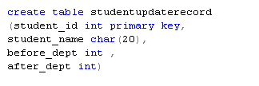
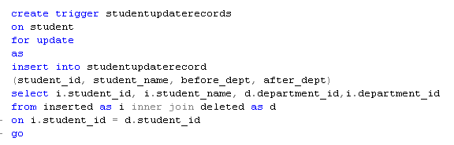

Slide 16

